Slide 1
UNIVERSITY OF LUCKNOW
FACULTY OF ENGINEERING AND TECHNOLOGY
2024-2025
Mechanical Engineering
PRESENTATION
Subject- Major Project
CODE:ME-754
B.Tech- IVth Year
Submitted to-
Dr. {}
Er. {}
Submitted by-
Aditya Patel | Ayush Mishra | Ashish Raj
2210013105002 | 2210013105012 | 2210013105011
Prashant Patel | Tanishq Maurya
2210013105026 | 2210013105036

Slide 2

Air-breathing Hypergolic LREs
By- Group 3

Slide 3
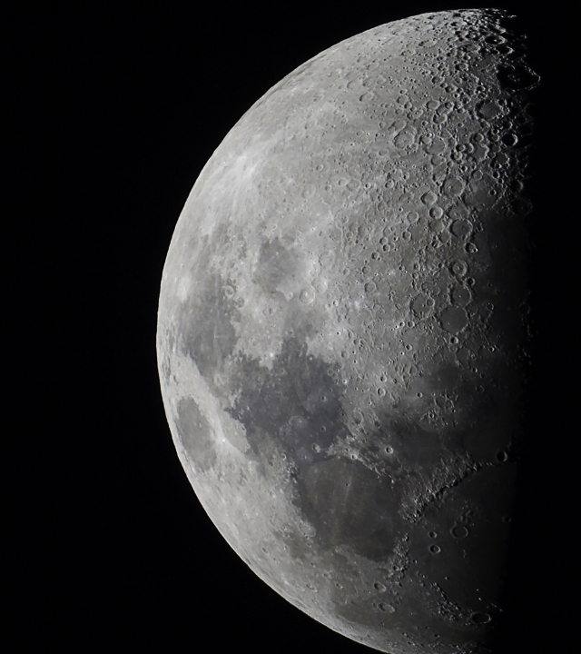
Agenda
UNDERSTANDING BASICS
DESIGN
BoM
CONCLUSION

Slide 4
“Reach for the moon, even if you miss, you'll land among the stars.”
Norman Vincent Peale

Slide 5
Process
Theory
Design
BoM
Recapitulation of Theory
Production
Calibration and testing

Slide 6

Nozzle theory and gas dynamics
A concise definition of Gas Dynamics, is the behavior of gases when their motion is fast enough (typically at high Mach numbers) that changes in density and temperature become significant, treating the gas as a continuous medium.
This behaviors of gas is expressed by Prandtl-Meyer relation
$$dv=\frac{\sqrt{M^{2}−1}}{1+\frac{γ−1}{2}M^{2}}\frac{dM}{M}$$

Slide 7
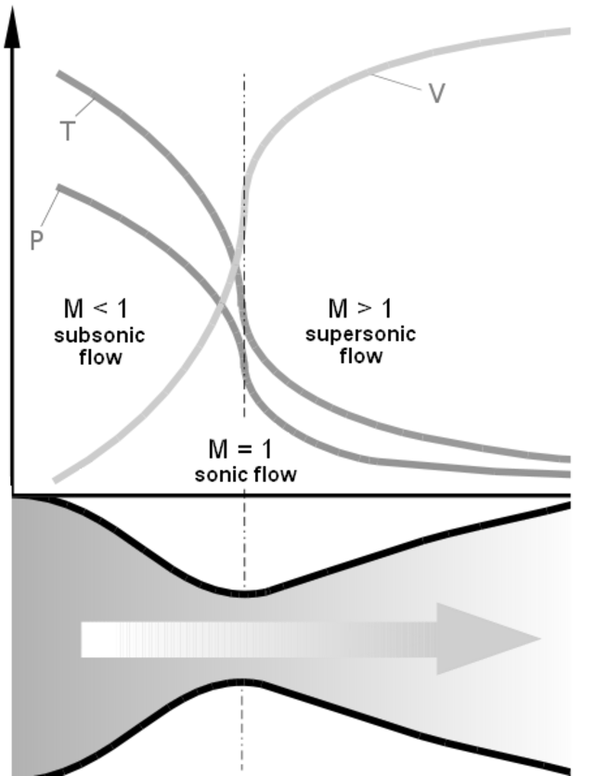
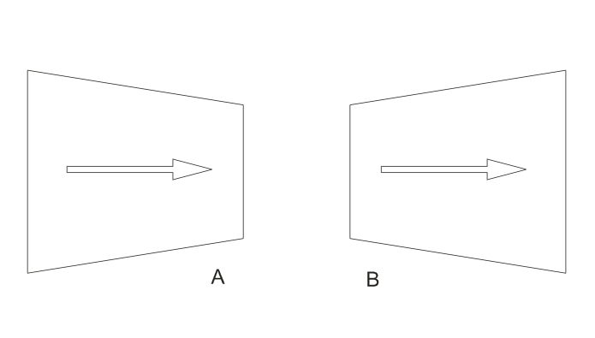

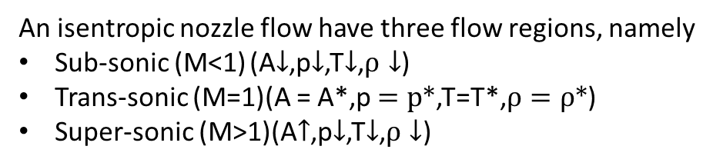
Flow Characteristics
An isentropic nozzle flow have three flow regions, namely
Sub-sonic (M<1) (A$↓$,p$↓$,T$↓$,$ρ↓$)
Trans-sonic (M=1)(A = A*,p $=p∗$,T=T*,$ρ=ρ∗$)
Super-sonic (M>1)(A$↑$,p$↓$,T$↓$,$ρ↓$)
$$\frac{dV}{V}=\frac{1}{M^{2}−1}\frac{dA}{A}$$

Slide 8
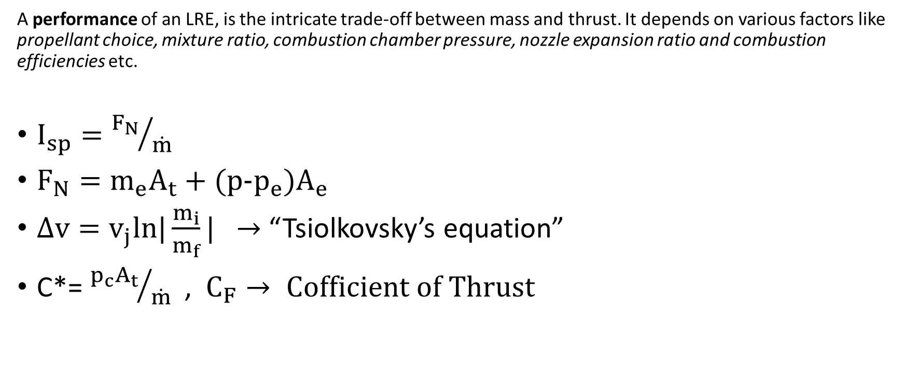
Performance
A performance of an LRE, is the intricate trade-off between mass and thrust. It depends on various factors like propellant choice, mixture ratio, combustion chamber pressure, nozzle expansion ratio and combustion efficiencies etc.
$I_{sp}={F_{N}}/{\dot{m}}$
$F_{N}=m_{e}A_{t}+(p−p_{e})A_{e}$
$∆v=v_{j}ln|\frac{m_{i}}{m_{f}}|$ $→$ “Tsiolkovsky’s equation”
C*= ${p_{c}A_{t}}/{\dot{m}}$ , $C_{F}→ Cofficient of Thrust$

Slide 9
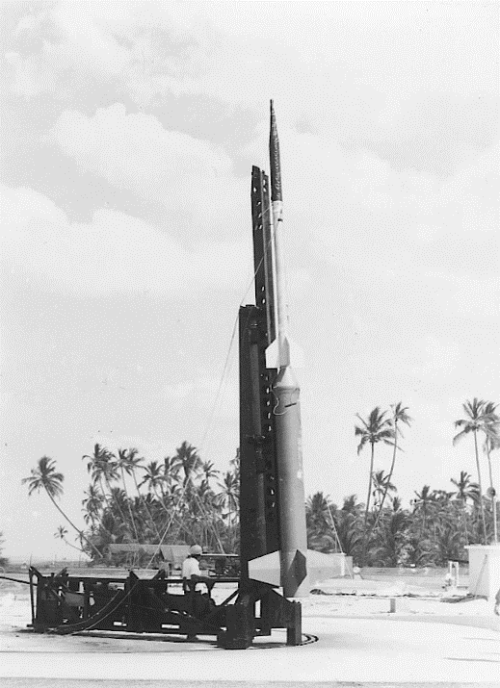
DESIGN

Slide 10
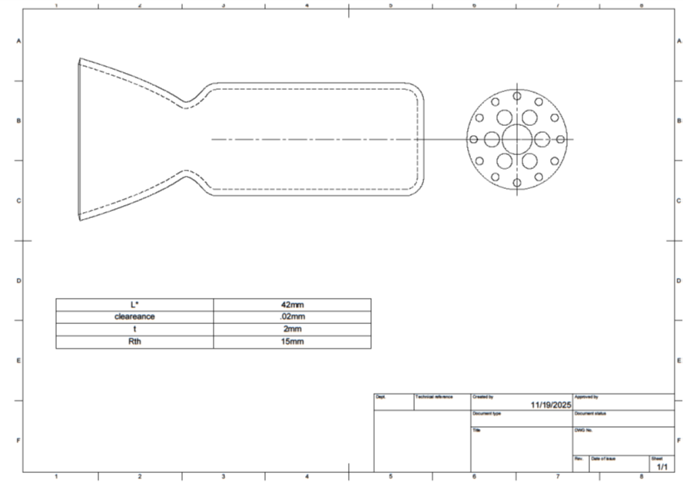
Structural Design
Design of combustion chamber
L* | 42mm
clearance | .02mm
t (thickness) | 2mm
R_{th} | 15mm

Slide 11
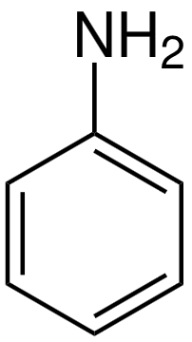
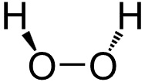


Choice of propellants
Fuel
Molecular mass $≈$ 93.13 g/mol
Stoic M.R = 2.83
$∆°H_{f}≈\text{31.3 }\text{Kj}\text{/}\text{mol}$
$C_{P}$(@298K)
Liquid: 1.92 J/g.K
Gas: 120.9 J/mol.K
Oxidizer
Molecular mass $≈$34.015 g/mol
Stoic M.R = 2.83
$∆°H_{f}≈\text{−187.8 }\text{Kj}\text{/}\text{mol}$
$C_{P}$ (@298K)
Liquid: 2.6 J/g.K
Gas: 43.0 J/mol.K
$$C_{6}H_{5}{NH}_{2}\left(l\right)+ \frac{31}{4}H_{2}O_{2}\left(l\right)→6{CO}_{2}\left(g\right) + \frac{17}{2}H_{2}O\left(l\right)+ \frac{1}{2} N_{2}\left(g\right)$$

Slide 12
Feed System
Feed system is the mechanism designed to efficiently provide the desired mass flow rate of propellant.
In this case, since we have Air- breathing engine we will be using a carburetion for feed and mixing of propellants.
Fuel
Air+ propellants
Atm. Air
Inlet
Combustion chamber
Oxidizer

Slide 13
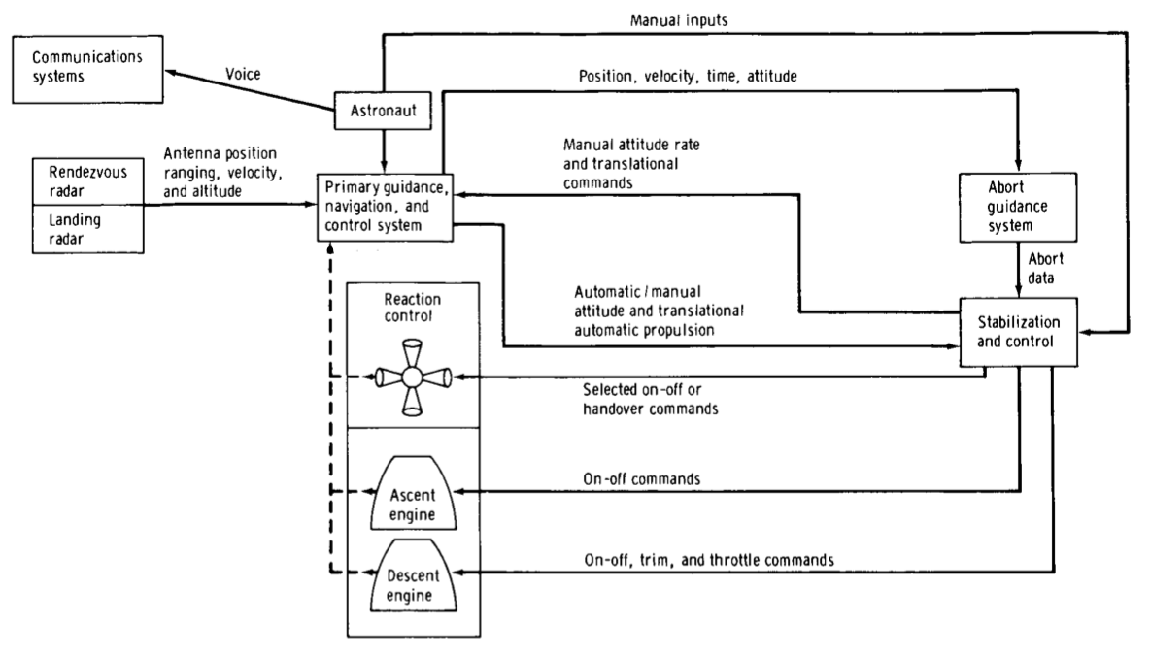
Control System Design
Control system design refers to a microcontrollers & actuators required to control the
A control system is necessary for numerous reasons, like;
Can be used to throttle or cut the flow of propellant
Can be used to change gimbal angle
Flight control and flight recorder
Active feedback Control
Notable example:

Slide 14
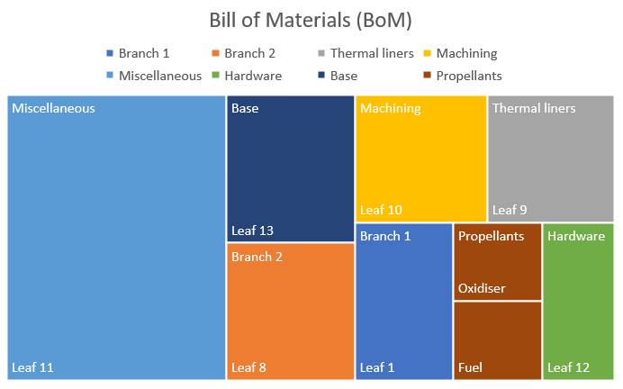
BoM (Bill of Materials)
Initial Estimate
Revisions
Final Estimate
AI Tools are really goods getting an initial estimate of bill of material, it accurately provides a rough idea of cost assessment

Slide 15
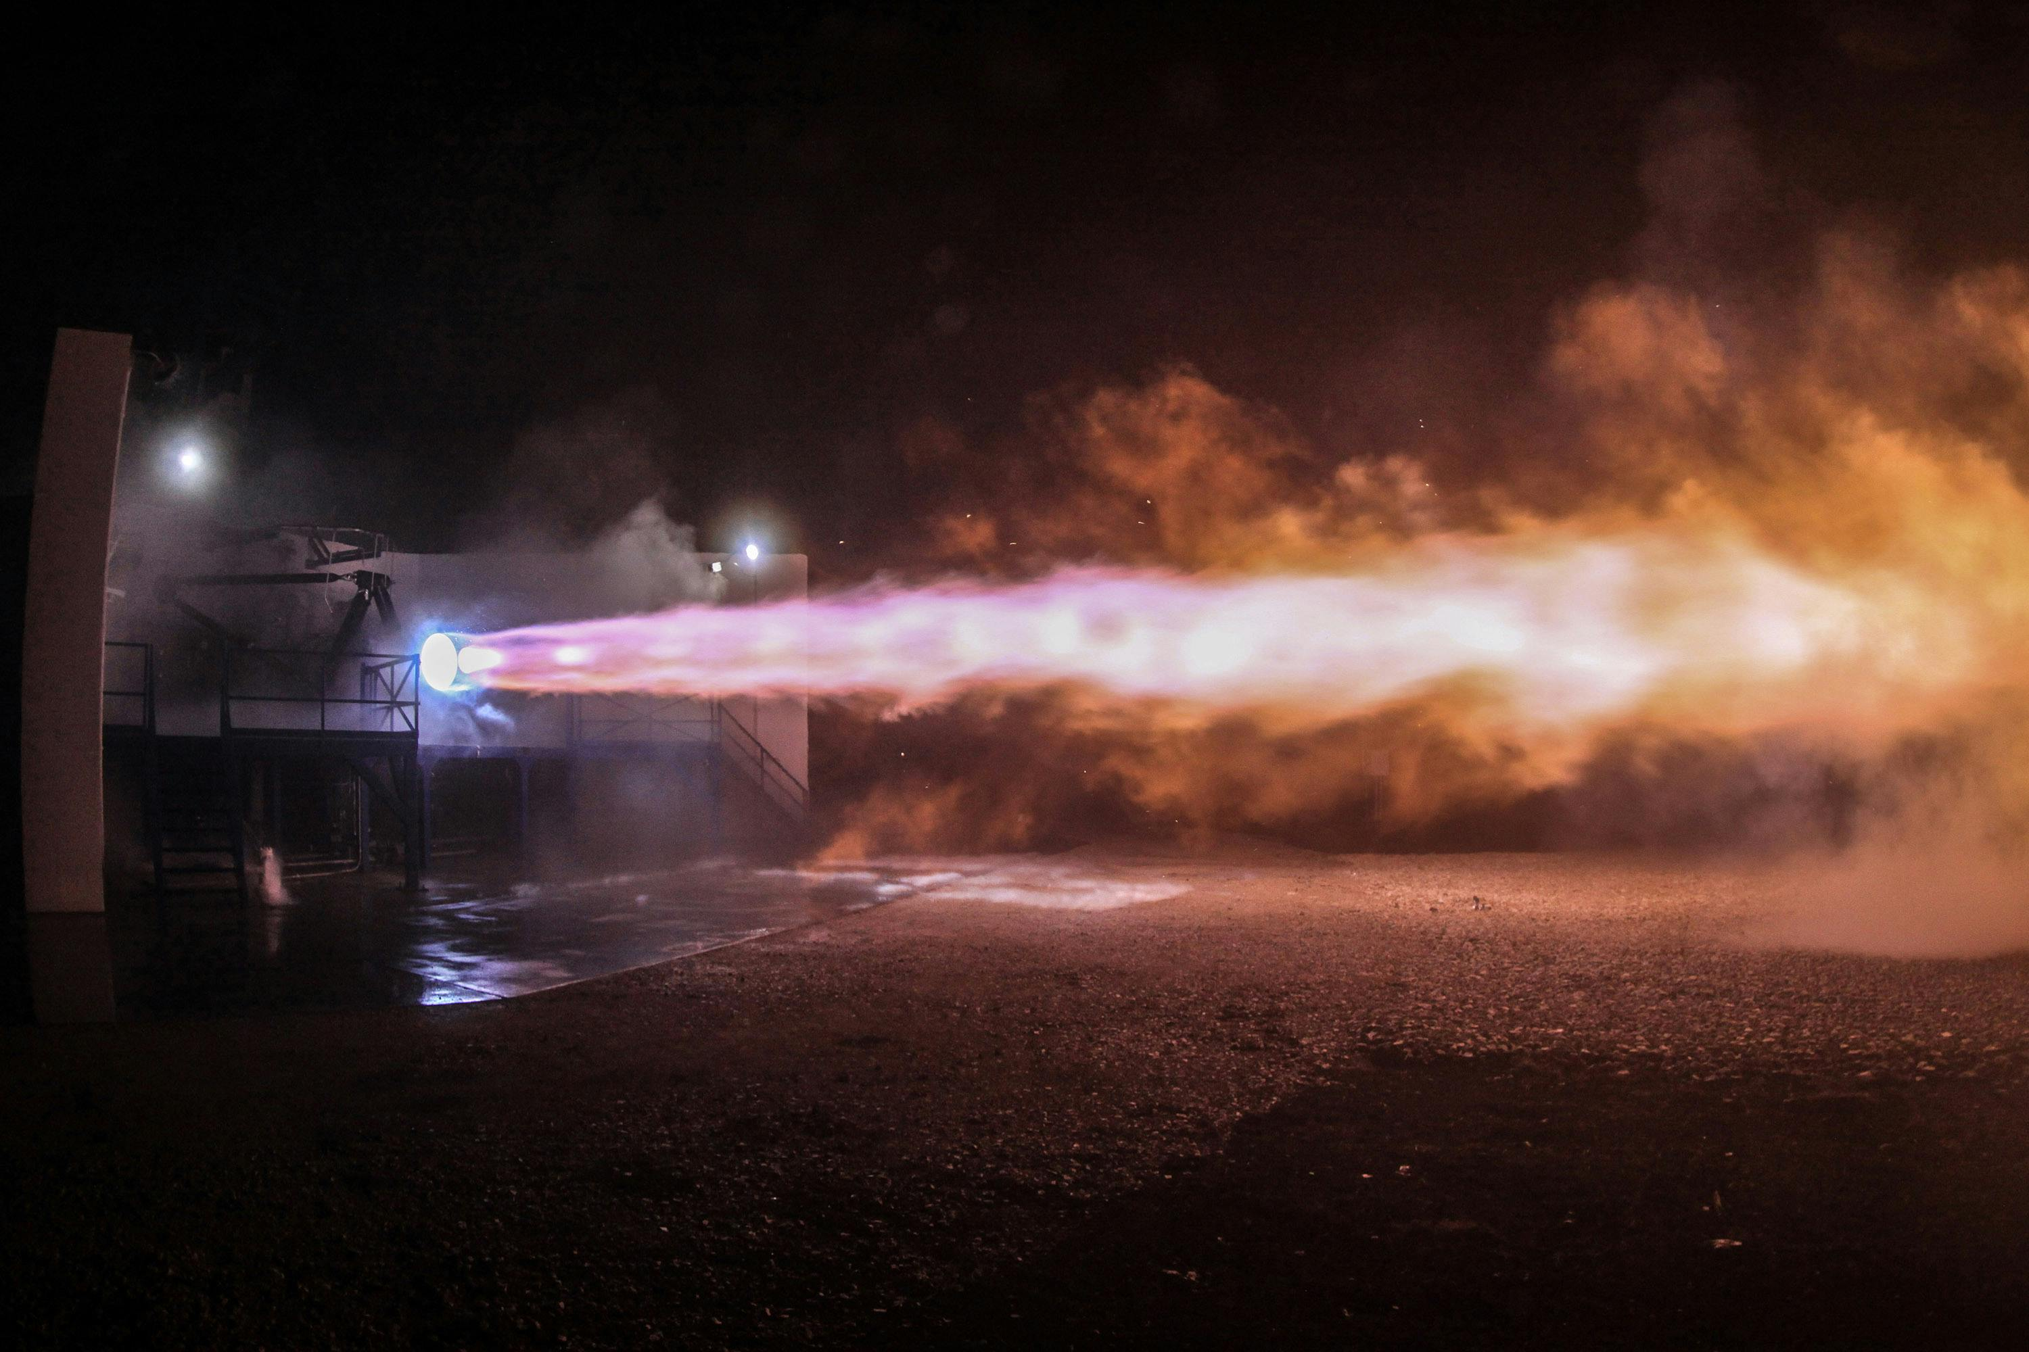
QUESTIONS?

Slide 16

THANKYOU
Thank
you

